Slide 1
Regional Course on Statistical Business Registers
Session 3: Introduction to SBRs (continued)
● Statistics & Research ● Other roles of SBRs ● UN Guidelines on SBRs

Slide 2
Overview
Session 2 covered the role of an SBR as a live register and as a coordinator of surveys
↓
Session 3 will cover the additional roles of SBRs including statistics & research
This Session will also review the UN Guidelines on SBRs

Slide 3
Additional Roles of the SBR
Statistics and research
SBR-derived statistics
Business demographics
Integration with domain-specific registers
SBR as a direct source of data
International data exchange
Modernization of statistical production and services

Slide 4
Statistics and Research
Why use SBRs?
Increasing demand from governments, international organizations and researchers for business statistics
Information provided must be consistent and comparable
NSOs looking to reduce data collection costs and response burdens

Slide 5

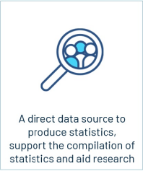
Statistics and Research
SBR-based statistics
Business demographics (births, deaths, etc.)
Integration with domain-specific registers, i.e. trade
SBR as a direct source of micro-level data/individual information
SBR regulatory framework
Lists of enterprises, ownership and control information, etc.
Geospatial

Slide 6
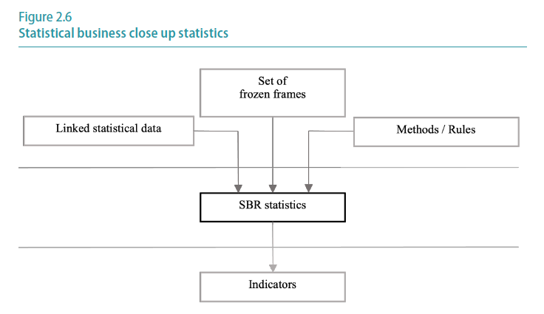
Statistics and Research

Slide 7
Statistics & Research
Business demography statistics
Provide data on the development of the business population over time and the core variables that describe this development
Focus is on the birth of new businesses, the survival of newly created businesses and the death of businesses
• Birth rate: newly born businesses in t as percentage of all active businesses in t
• Survival rates: percentages of businesses born in t that are still active in t+1, t+2, t+3, etc
• Death rate: businesses closed in t as percentage of all active businesses in t

Slide 8
Statistics & Research
Business demography statistics
Can be broken down by:
Economic activity (ISIC)
Legal form
Size or rate of growth (employment or turnover)
Region
Sole proprietorships/owner-occupiers:
Can be analyzed by characteristics of the entrepreneur i.e. age, gender

Slide 9
Statistics & Research
Business demography statistics
Populations used:
All businesses (“business demography”)
Businesses with at least one employee (“employer business demography”)
Businesses with at least two employees (“economic business demography”)
Using all businesses is most comprehensive, however excluding self-employed businesses increases international comparability
Requiring 2+ employees guarantees to exclude cases where the entrepreur is counted as an employee

Slide 10
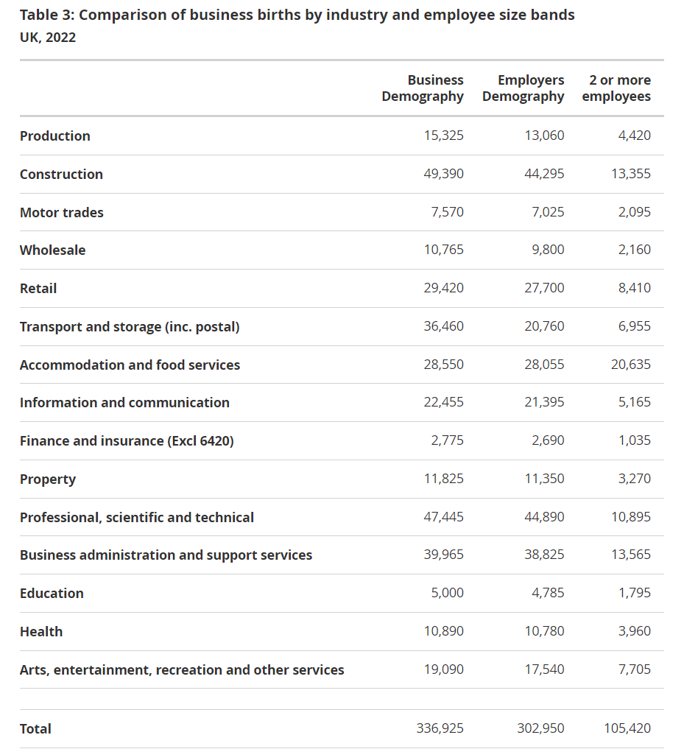
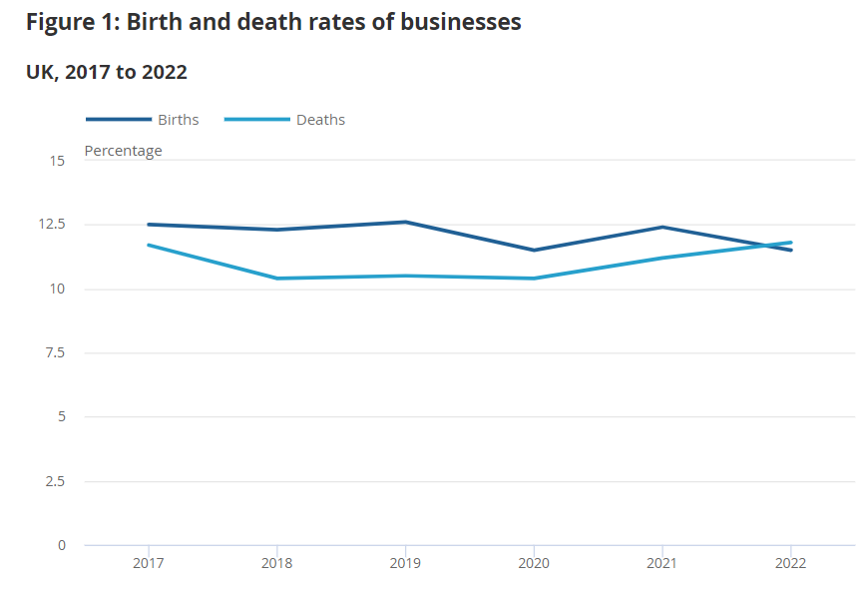
Statistics & Research
Business demography statistics
Example of SBR-derived demographics from the UK

Slide 11
Statistics & Research
Business demography statistics
Satellite approach
Issues
Changes in concepts or coverage as a result of SBR maintenance can lead to changes in data unrelated to changes in the real world
Implementing additional roles can lead to a complex network of databases and functionalities
Possible solution
Frozen frames from the SBR are linked with other data sources and maintained separately in a satellite register
Benefits
Reduced complexity of SBR
Statistics can be produced by those outisde the SBR unit
Can handle more data; not interfere with basic functions of SBR

Slide 12
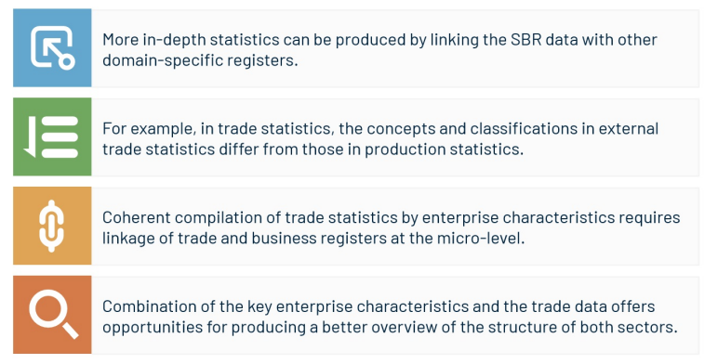
Statistics & Research
Integration with domain-specific registers

Slide 13
Statistics & Research
Integration with domain-specific registers
Example of Tunisia
Customs data was linked to the SBR:
Imports/exports by company
Information on the products imported/exported, i.e. value, weight and destination
Also facilitates updates and estimations in the SBR, i.e.
Estimate turnover based on value of exports for exporting companies
Estimate main business activity based on most imported/exported products

Slide 14
Statistics & Research
Integration with domain-specific registers
Example of Tunisia
Customs initially used their own company identifiers
In 2010, adopted the identifiers used by the tax authorities
Integration of files now automated

Slide 15
Statistics & Research
SBR as a direct source of micro-level data
Provision of SBR micro (individual) data as open data, publicly available for any individuals or organizations to use and licensed in a way that makes reuse possible
Scope of this role dependent on the regulatory framework:
Confidentiality and privacy
Legislative considerations
And dependent on available dissemination infrastructure:
i.e. Geostatistical

Slide 16
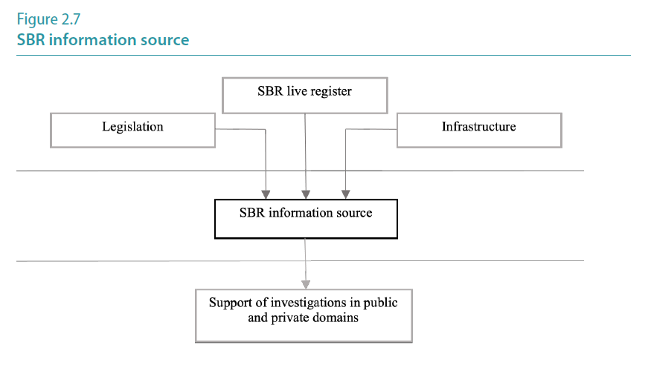
Statistics & Research

Slide 17
Statistics & Research
SBR as a direct source of micro-level data
While confidentiality provisions must be observed, much of the enterprise data is public
Ideally the regulatory framework would allow dissemination of:
Identification and stratification characteristics: enterprise name, denomination or corporate name, economic activity class, size class
Geographical location characteristics: street, external and internal number, neighbourhood, postal or zip code, locality
Geographical coordinates of the location: latitude and longitude
Contact characteristics: phone, fax, email, and web page
Date of creation of the unit

Slide 18
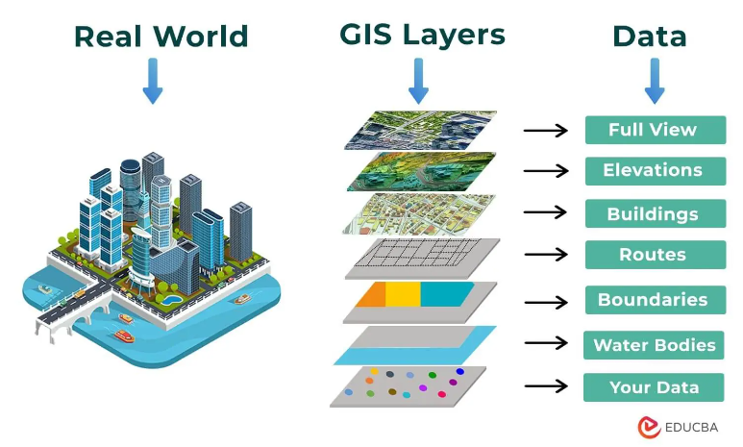
Statistics & Research
SBR as a direct source of micro-level data
Geostatistical information
Growing interest in/availability of geographical information systems (GIS)
Coordinates can be assigned to addresses
Possible “information layers”:
Urban services
Natural resources
Hydrographic networks
Communication routes

Slide 19
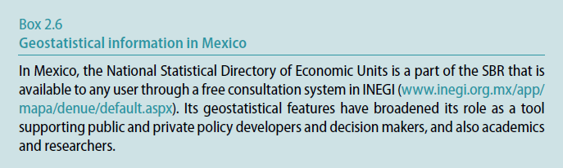
Statistics & Research
SBR as a direct source of micro-level data
Geostatistical information
Example of Mexico
https://en.www.inegi.org.mx/siscon/

Slide 20
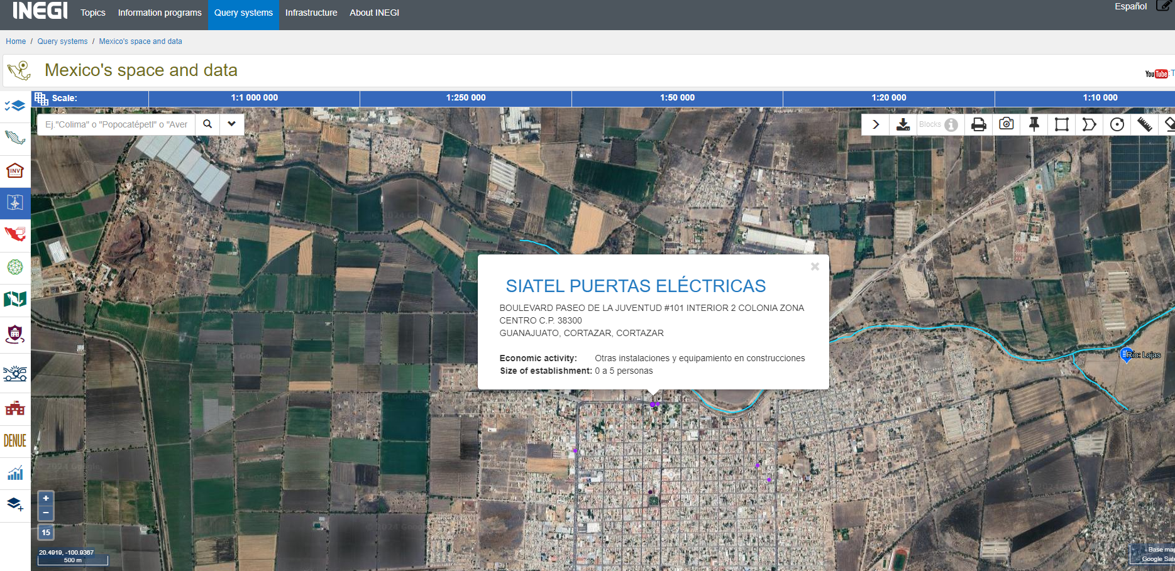
Statistics & Research
SBR as a direct source of micro-level data
Geostatistical information

Slide 21
Other Roles of an SBR
International data exchange and comparability
Can allow for harmonization of data to facilitate collaboration across regions
Modernization of statistical products and services

Slide 22

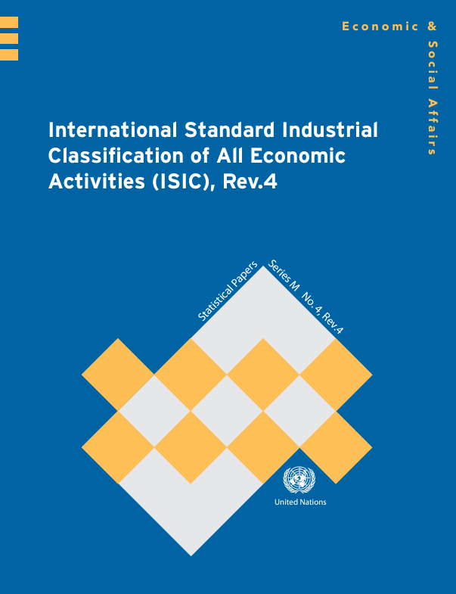
Other Roles of an SBR
International data exchange and comparability
As globalization increases, the importance of internationally comparable data increases
SBRs must maintain internal/external coherence
EuroGroups Register (EGR): example of data exchange network between NSOs

Slide 23
Other Roles of an SBR
International data exchange and comparability
Confidentiality
No international standards
Limited by requirements: data for statistical use only, cannot disclose data about individual units
Countries responsible for compliance with their own regulations as well as those from sending countries

Slide 24
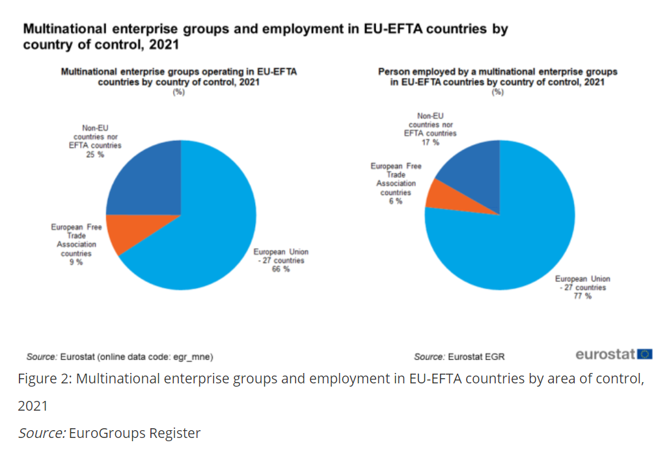
Other Roles of an SBR

Slide 25
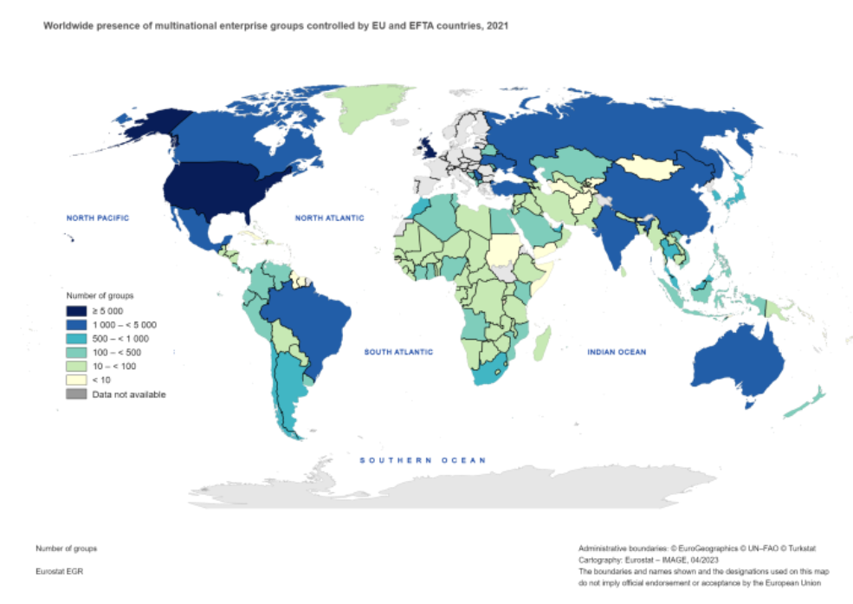
Other Roles of an SBR

Slide 26

Other Roles of an SBR
International data exchange and comparability
Cooperation and trust required
ECE Guide to Sharing Economic Data:
Specific examples of sharing of economic data
Identifies obstacles
Provides guidance
https://unece.org/sites/default/files/2021-02/Data%20sharing%20guide%20on%20web_1.pdf

Slide 27
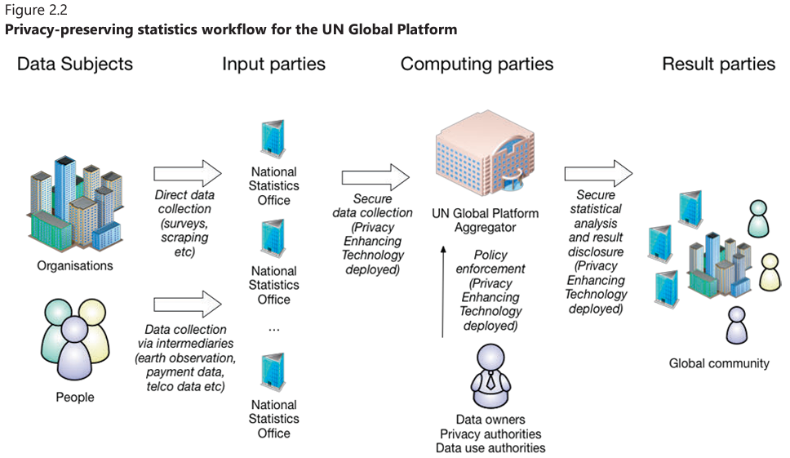
Other Roles of an SBR

Slide 28
Other Roles of an SBR
Modernization of statistical products and services
Key elements: efficiency, coherence, interoperability and cooperation
The Generic Statistical Business Process Model (GSBPM) A standard but flexible tool for describing and defining the common set of business processes that typically constitute statistical production
https://statswiki.unece.org/display/GSBPM/
SBR fulfils a backbone role in this respect by integrating several data sources and supporting the collection of economic data

Slide 29
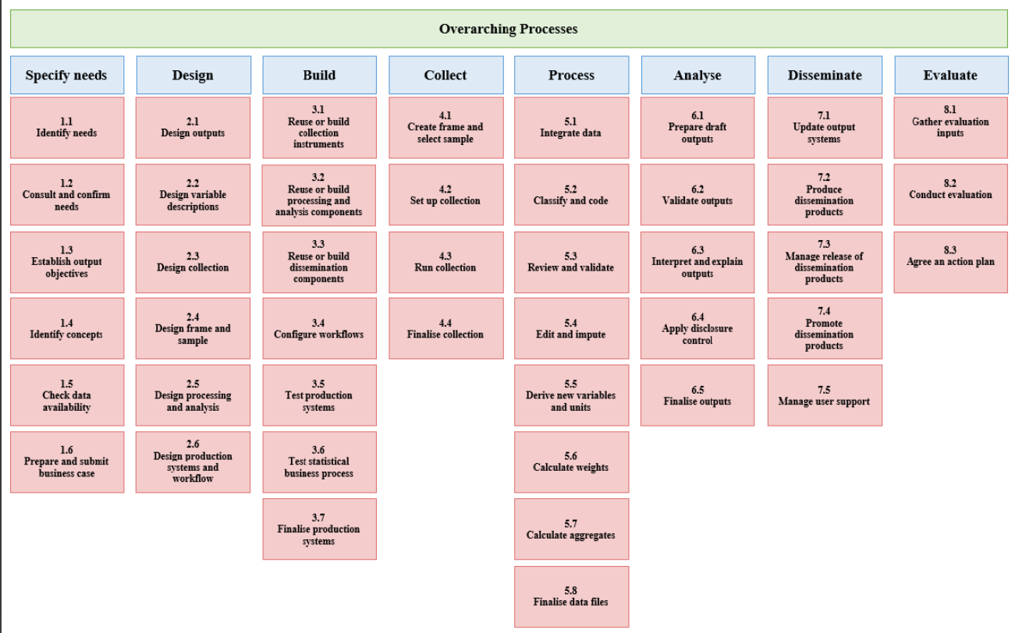
Other Roles of an SBR
GSBPM

Slide 30
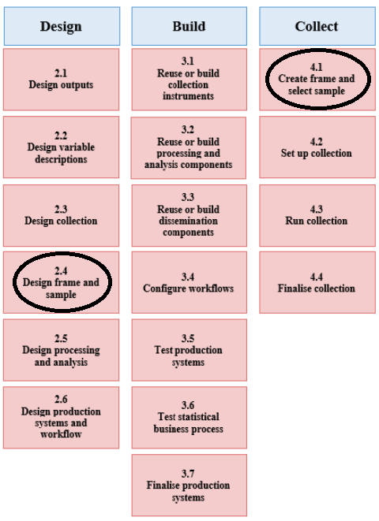
Other Roles of an SBR

Slide 31
Other Roles of an SBR

Slide 32
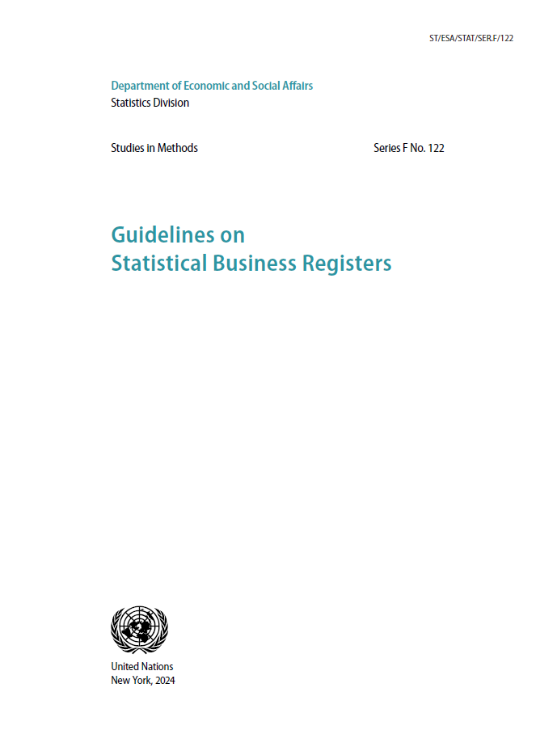
UN Guidelines on SBRs
Publication in process: pre-edited version available on website
https://unstats.un.org/unsd/business-stat/SBR/Documents/UN_Guidelines_on_SBR.pdf
Editing being finalized now
Builds on ECE Guidelines, addressing the specific needs of countries with less-developed statistical system
Many specific country examples

Slide 33
UN Guidelines on SBRs
1. Introduction
2. Roles of the statistical business register
3. Coverage of the statistical business register
4. Units in the statistical business register
5. Characteristics of units
6. Data sources for the statistical business register
7. Maintenance of the statistical business register
8. Survey frame methodology
9. Dissemination
10. Quality
11. Key considerations in establishing a statistical business register
12. Topics for further work and research

Slide 34
UN Guidelines on SBRs
Questions/Exercise

Slide 35
UN Guidelines on SBRs
Which roles does your SBR currently perform?
Live register
Coordinating surveys
Business demographics
Direct source of data
International data exchange
Modernization of statistical production
Which of the above roles could your SBR possibly perform in the near future? What would it take to achieve this?

Slide 36
UN Guidelines on SBRs
Thank you!

